Slide 1
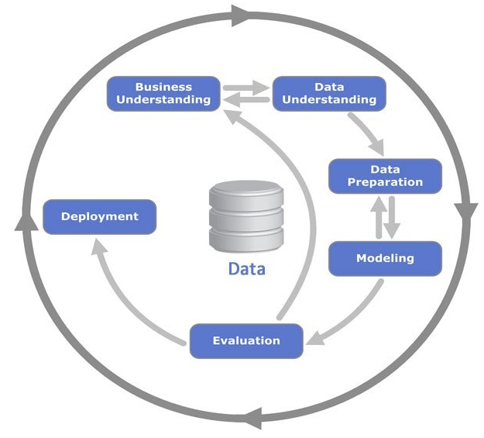
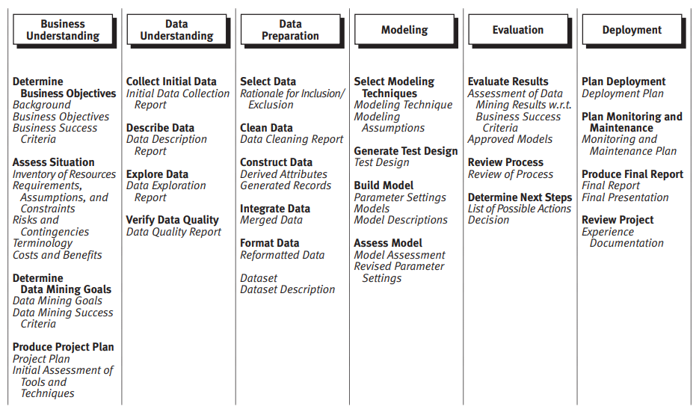
CRISP-DM Framework
https://www.datascience-pm.com/crisp-dm-2/

Slide 2
CRISP-DM Framework
https://www.datascience-pm.com/crisp-dm-2/

Slide 3
Business Understanding
BACKGROUND:
With the rapid development of telecommunication industry, the service providers are inclined more towards expansion of the subscriber base. To meet the need of surviving in the competitive environment, the retention of existing customers has become a huge challenge. It is stated that the cost of acquiring a new customer is far more than that for retaining the existing one. Therefore, it is imperative for the telecom industries to use advanced analytics to understand consumer behavior and in-turn predict the association of the customers as whether or not they will leave the company.
Important points
Inclined customer
Competitive environtment
Cost acquiring customer > cost retaining customer
Leaving company means revenue loss
Problem statement : how might we retain customer with high churn risk so we can prevent revenue loss ?
SOME BUSINESS OBJECTIVE AND SUCCES CRITERIA:
Business Objective | Success Criteria
Prevent revenue loss | Save at least at least 70% of revenue loss over the next period by retaining customers identified as high risk churned

Slide 4
Business Understanding
True | Churn Prediction (proba > threshold)
 | Low risk churn | High risk churn
Stay | Staying Customer | Inacurate Retention Effort
Churn | Undetected Churner | Detected Churner
DATA MINING GOALS:
Minimize (Undetected Churner + Inacurate Retention Effort)
DATA MINING SUCCES CRITERIA:
We can minimize both “Undetected Churner” and “Inacurate Retention Effort” using classification metrics f1 score. By using this criteria in the end we hope we can prevent revenue loss as much as possible

Slide 5
Business Understanding
ASSUMPTION:
retention cost take up 5% of monthly charges per customer
let's say we are doing some retention campaign. succes rate is 80%.

Slide 6
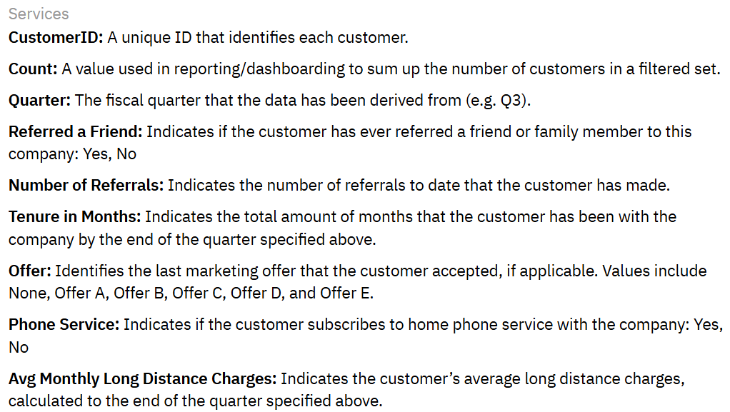
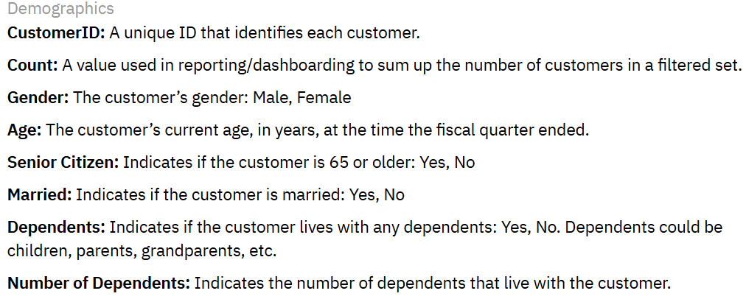
Data Understanding
COLLECT INITIAL DATA:
In data collection, data was gathered from many sources such as
Geographic
Demographic
Customer service usage
Csutomer current profile
DESCRIBE DATA:
Some data description

Slide 7
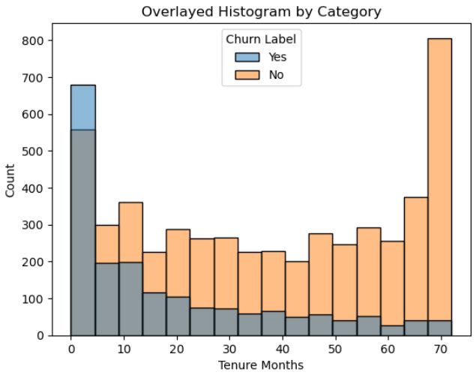
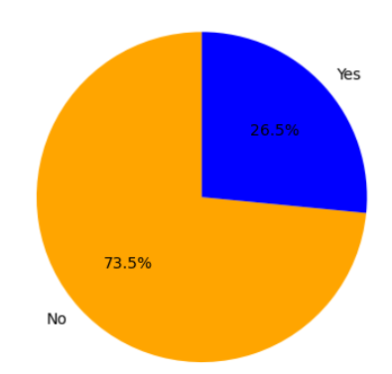
Data Understanding
Churn ?
Explore Data:
26.5% customer labeled as churn. These customer can cause revenue loss for current period.
So many factor related to churn. For example, old customer tend to stay than churn.
Monthly Charge Loss According to Current data:
There are 7043 customer in current month : 1869 (26.5%) labeled as churn and 5174 (73.5%) labeled as non churn
From 1869 churn customer, company will lose US$456,116 this month. We aim to decrease this loss.

Slide 8
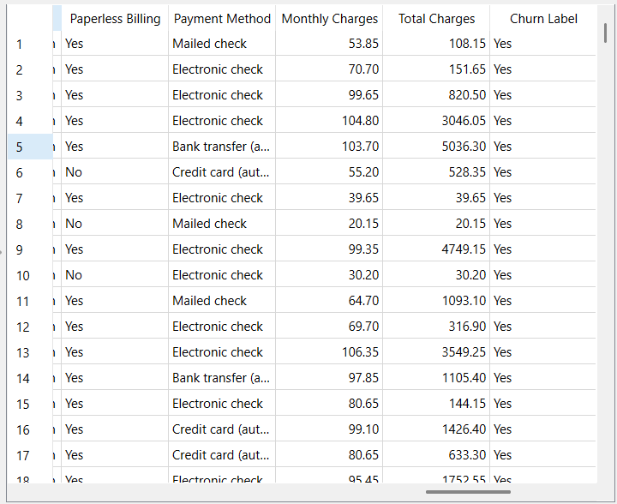
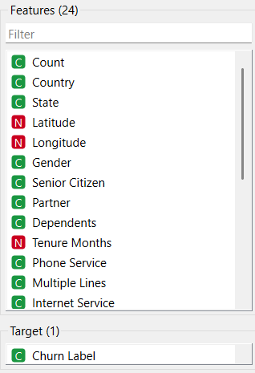
Data Preparation

Slide 9
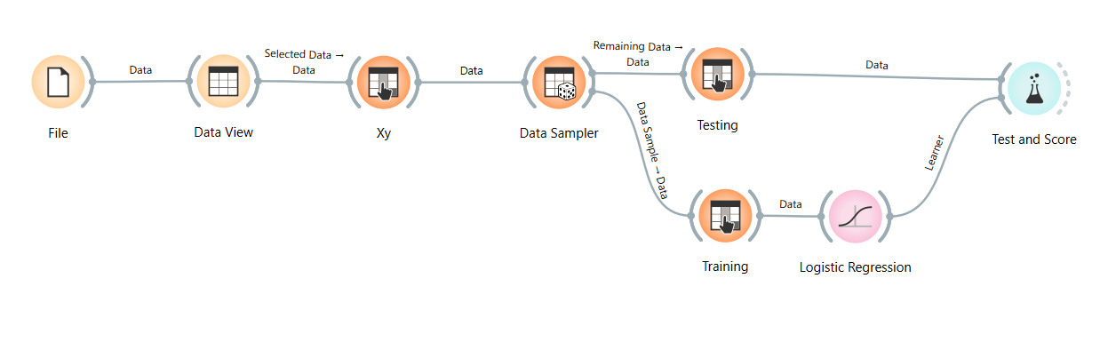

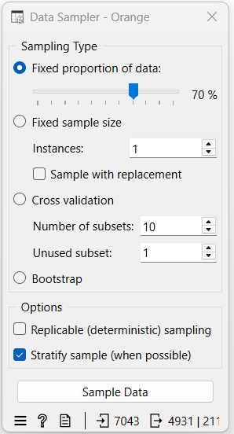
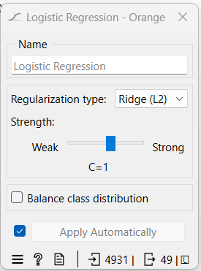
Modeling
Model Assesment
Test Design
Test Design
Build Model
Modeling Technique

Slide 10
Evaluation
True | Churn Prediction (proba > threshold = 0.6)
 | Low Churn Risk | High Churn Risk
Stay | Staying Customer | Wasted Retention Cost
Churn | Undetected Monthly Charge Loss | Potentialy Saved Monthly Charge
Wasted Retention Cost = sum of (customer in “high risk” and staying customer) x (5% of monthly charge per customer)
Undetected Monthly Charge Loss = sum of (number of customer in “low risk” and churning customer) x monthly charge
Potentialy Saved Monthly Charge = sum of (number of customer in “high risk” and churning customer) x monthly charge per customer x retention campaign succes rate

Slide 11
Evaluation
EVALUATE RESULT:
“We can save up to 76.06% of potential monthly charge loss for the next period. For example, If potential loss US$112605 then we can save US$89442 (76.06% of potential loss)”
REVIE PROCESS:
It’s still an MVP
ML model can still be optimized
Scenario could be different
DETERMINE NEXT STEP:
Model improvement (we can do some improvement next time!)
In real word scenario, Discuss more fitting scenario with business team

Slide 12
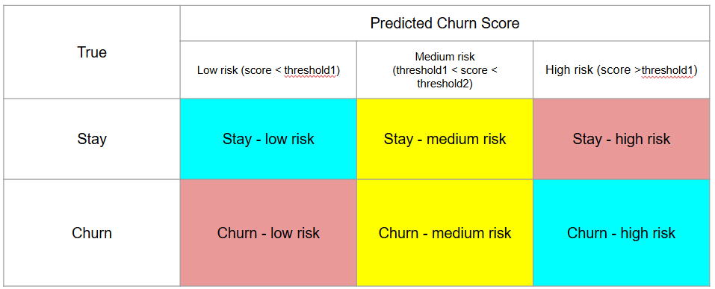
Evaluation
ANOTHER SCENARIO:
Another scenario that may be more fitting for business team

Slide 13
Deployment
PLAN DEPLOYMENT:
We can start from estimating revenue loss that can be saved every month
Then adjust the budget for development cost-benefit wise.
Whether it’s cloud base or on premise
PLAN MONIORING AND MAINTENANCE:
Data will be updated probably every month
Data structure can be changed
New variables probably coming
Business requirement can be different and affect relevancy of the solution

Slide 14
Disclaimer
I’m aware, ML model can still be optimized. It’s still an MVP!
Scenario could be different
Still so many thing can be improved. The take away is how to translate business problem into solution, measure it’s impact, and structurize the use case using CRIP-DM framework.
We were trying to understand the use case and fit CRISP-DM using the available data. Some information may not be available.
In reality, this will be far more complex. I’m trying to simplify it.

